Slide 1

Unicorn Data Insights 2015-2018
By Crystalyn Manteca

Slide 2

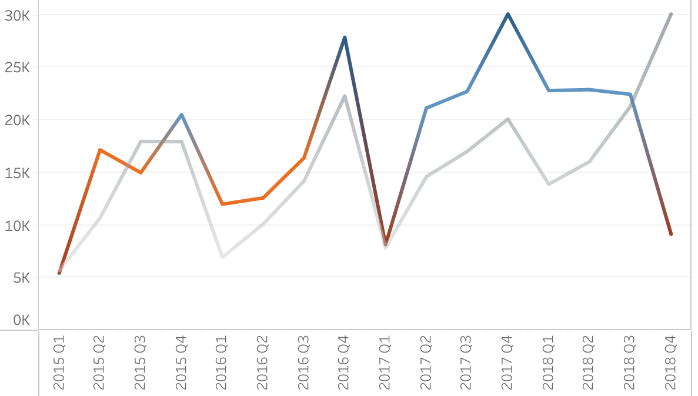
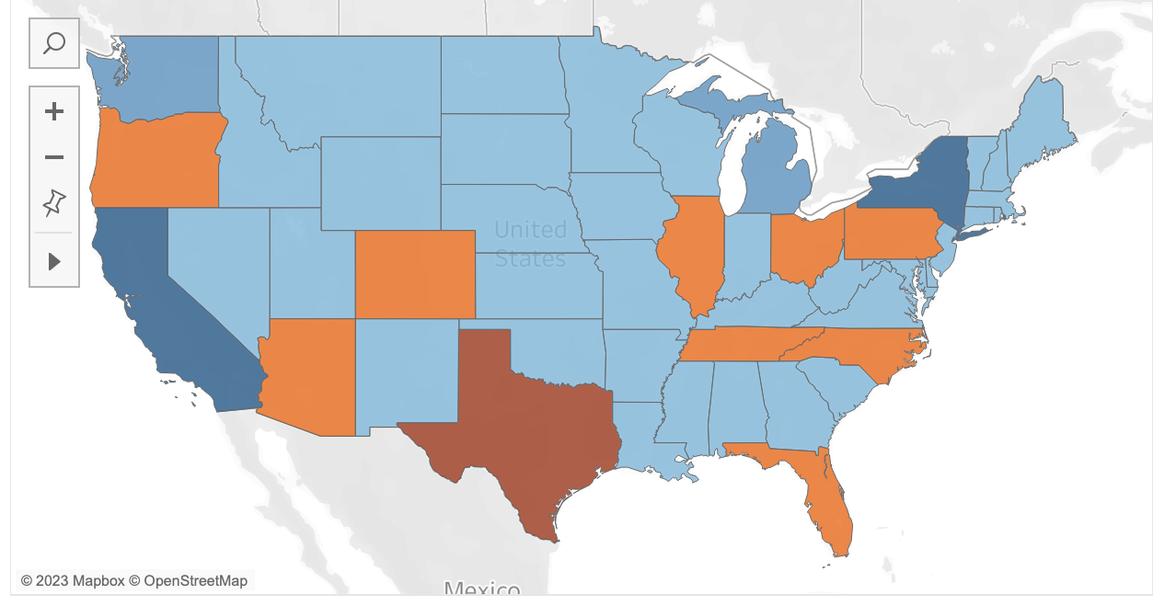
What are we looking for?
Profit VS Sales by Quarter
When first going through the dataset we asked some key questions to begin our analysis.
How did profit and sales change through time? Do we see any patterns or spikes?
What was the lowest and highest profitable state/region? What are they buying?
Profit by State

Slide 3

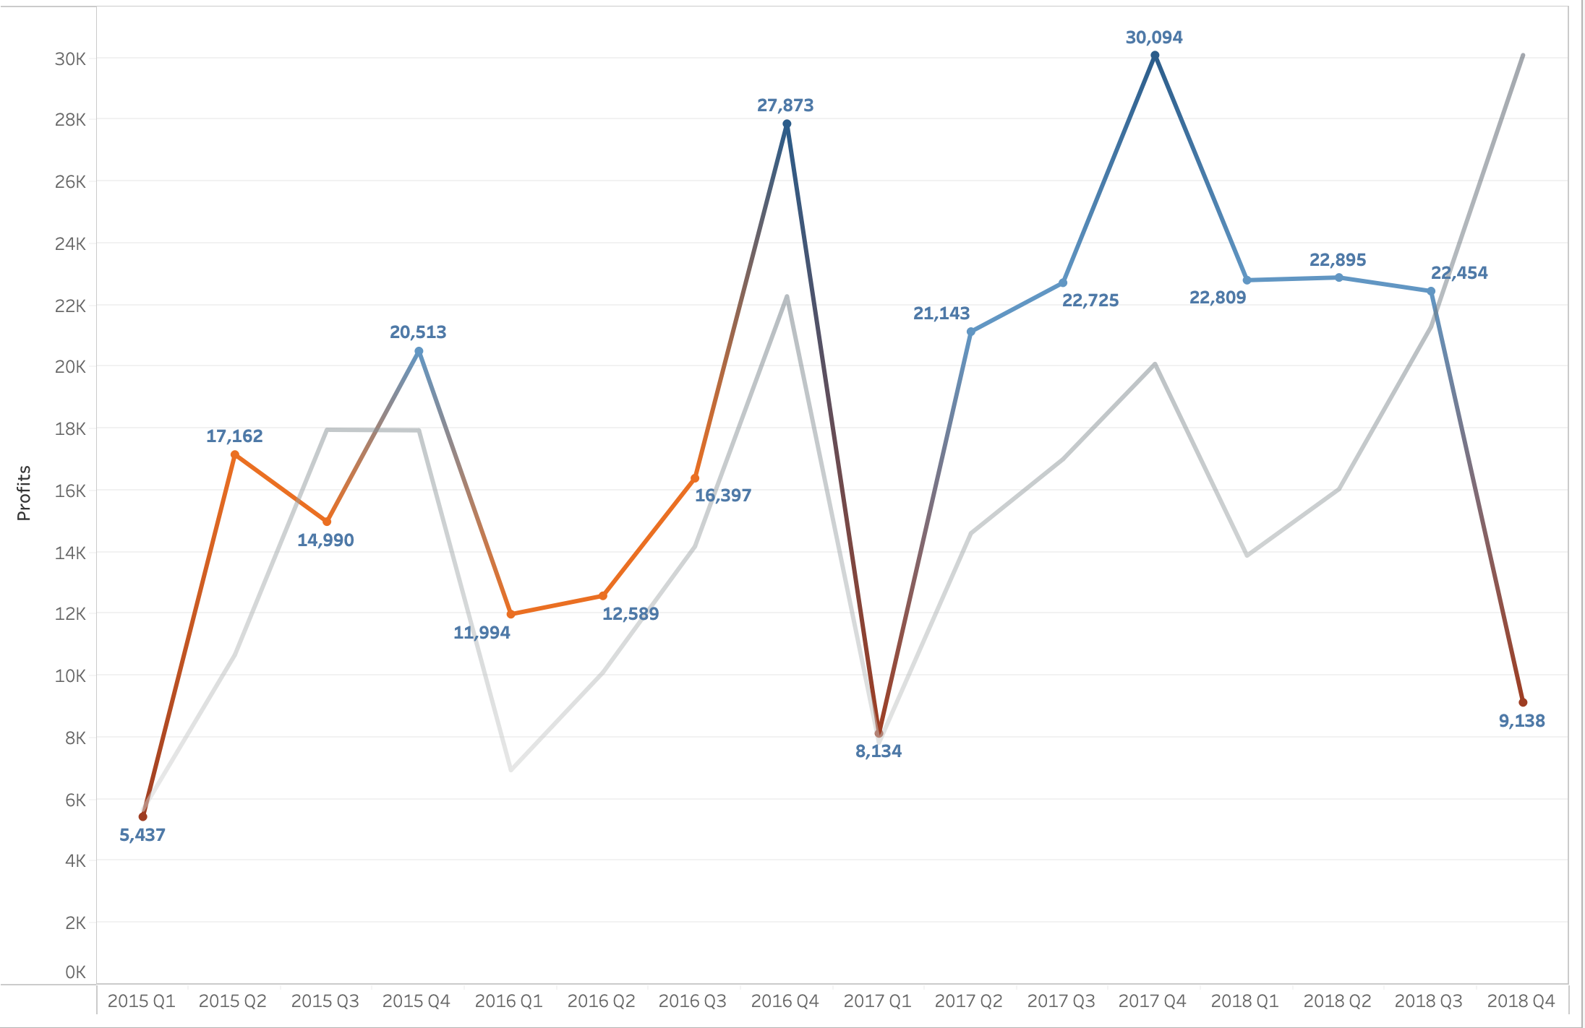
Highs vs lows
We notice that the highest profitable quarter was Q4 2017 with a total profit of $30,094.
Since then, we see a steady decline in profits but increase in sales.
We then hit to Q4 2018 with the lowest profit margin since Q1 2015. What caused such a decline?

Slide 4
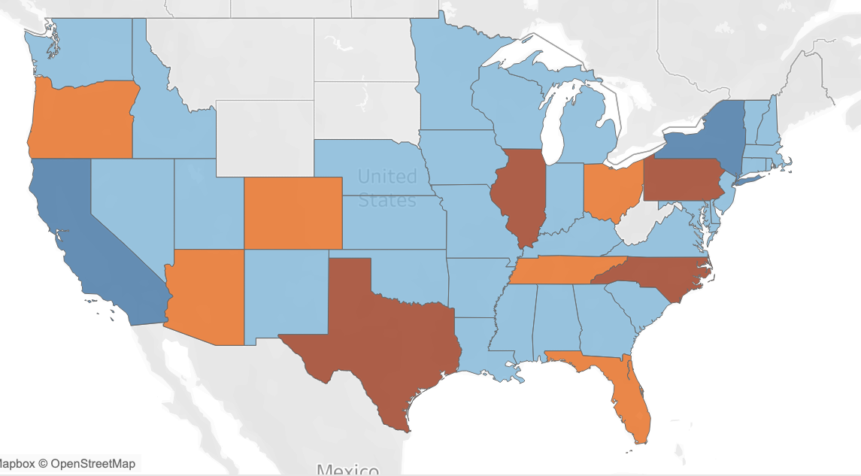
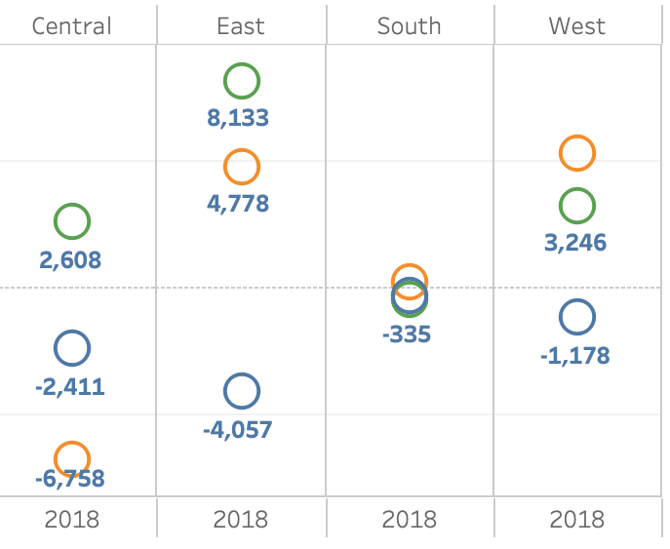
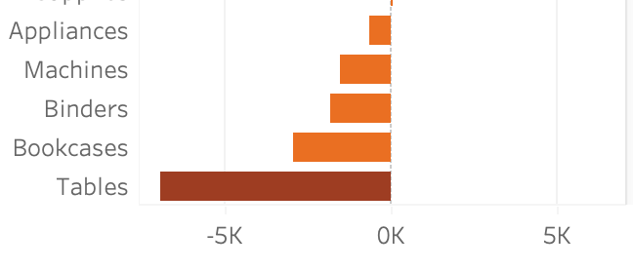
Q4 2018 DEEP DIVE
We notice the biggest negative profit margin is in the Central region followed by the East.
Most of this spending was on office supplies and furniture. Specifically, spending on binders, bookcases, and tables.
Which state is causing the most net loss? Let's take a closer look.

Slide 5
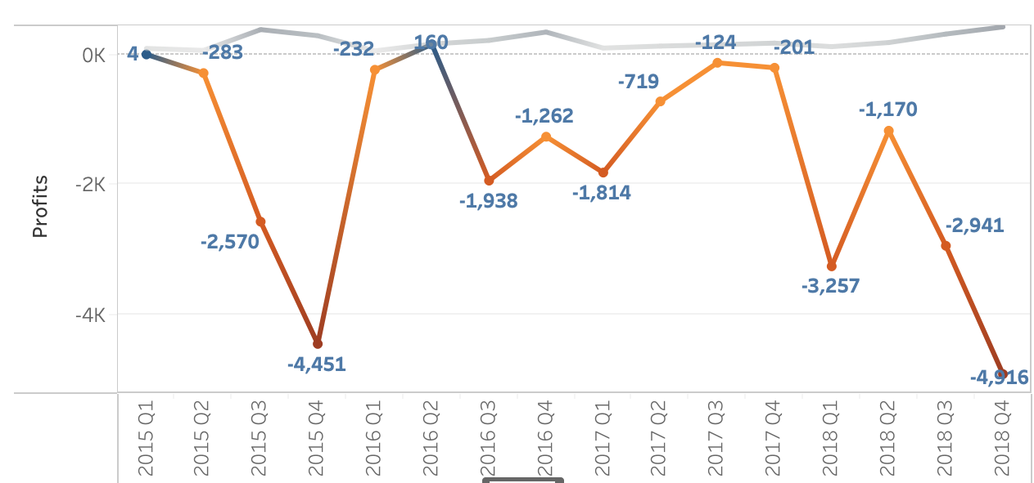
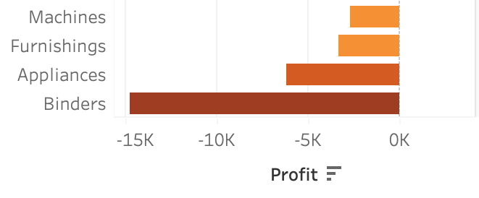
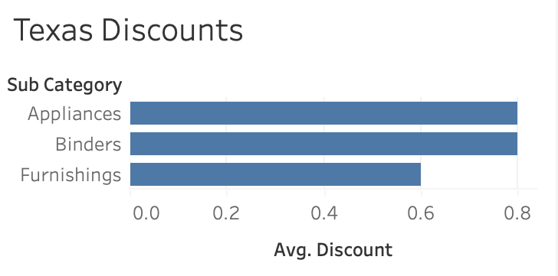
Texas
Texas contributed to the largest net loss of $25,714, and consistent in its trend downwards.
Looking into the subcategories, we notice binders have the largest loss. What is causing this? Discounts.
When ordered by discount, binders has an overall average order discount of 80% in Texas whereas all other states have a discount of 32%.

Slide 6
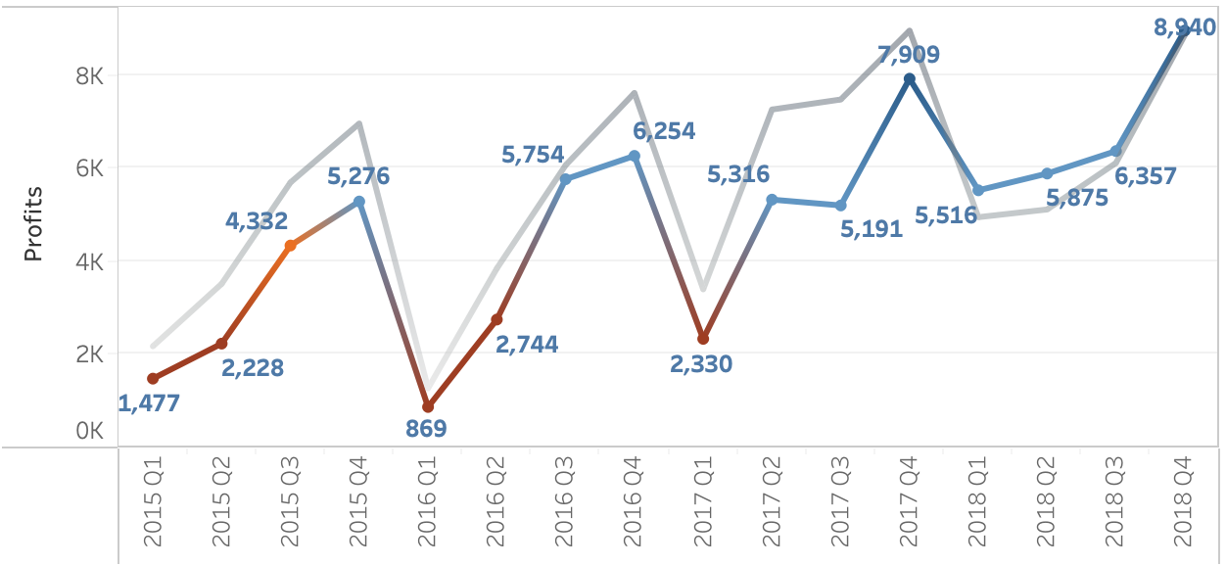
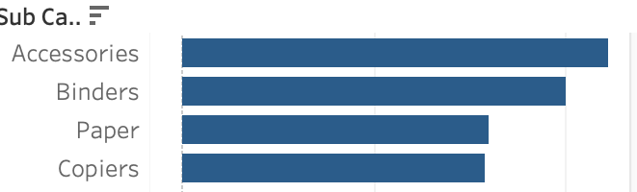
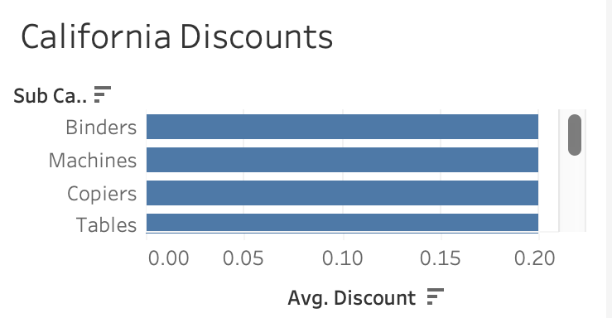
California
The highest profitable state was California with a total profit of $76,368, and trending upwards.
We also noticed it had:
Most sales throughout data
Most quantity sold throughout, except for 2015
Highest overall order to profit ratio
The highest sold category is office supplies, as opposed to technology in the other states. Pairing down to sub-category, we noticed accessories and binders are the top sellers.
In comparison to Texas, we notice their discounts for binders are 20% which is not only 60% less than Texas, but also lower than the 32% national average.

Slide 7
Recommendations
Connect with sales team on how compensation in incentivized. Could we set a goal by region for a profit or discount percent target?
Connect with the inventory and product team on sub-categories that appear to be underperforming.
Focus on scaling back higher discounts in the Central region, specifically Texas.
Provide this dashboard with filters for each regional lead so they can track on their own.

Slide 8

Thank you!

